Slide 1
7.2 Ship Drive Train and Power
Ship Drive Train System
EHP
Engine
Reduction
Gear
Screw
Strut
Bearing
Seals
THP
BHP
SHP
DHP

Slide 2
Ship Drive Train and Power
EHP
Engine
Reduction
Gear
Strut
Screw
Bearing
Seals
THP
BHP
DHP
SHP
Brake Horsepower (BHP)
- Power output at the shaft coming out of the engine before
the reduction gears

Slide 3
Ship Drive Train and Power
EHP
Engine
Reduction
Gear
Strut
Screw
Bearing
Seals
THP
BHP
SHP
DHP
Shaft Horsepower (SHP)
- Power output at the shaft coming out of the reduction gears

Slide 4
Ship Drive Train and Power
EHP
Engine
Reduction
Gear
Strut
Screw
Bearing
Seals
THP
BHP
DHP
SHP
Delivered Horsepower (DHP)
- Power delivered to the propeller
- DHP=SHP – losses in shafting, shaft bearings and seals

Slide 5
Ship Drive Train and Power
EHP
Engine
Reduction
Gear
Strut
Screw
Bearing
Seals
THP
BHP
DHP
SHP
Thrust Horsepower (THP)
- Power created by the screw/propeller
- THP=DHP – Propeller losses
- THP is the end result of all HP losses along the drive train

Slide 6
Ship Drive Train and Power
BHP
SHP
DHP
THP
EHP
E/G
R/G
Shaft
Bearing
Prop.
Hull
Relative Magnitudes
BHP > SHP > DHP > THP > EHP
The reverse relationship can NEVER be true because there is
ALWAYS some loss of power due to heat, friction, and sound

Slide 7
7.3 Effective Horsepower (EHP)
The power required to move the ship hull at a given speed in the absence of propeller action
EHP is not related to Power Train System
EHP can be determined from the towing tank experiments at
the various speeds of the model ship
EHP of the model ship is converted into EHP of the full scale
ship by Froude’s Law.
Measured EHP
V
Towing Tank
Towing carriage

Slide 8
Effective Horsepower (EHP)
Typical EHP Curve of YP
The required EHP varies depending on the vessel’s speed.

Slide 9
Effective Horsepower (EHP)
EHP Calculation

Slide 10
7.4 Propulsion Efficiency
The loss in HP along the drive train can be related in terms of
EFFICIENCY, or “η”
Gear Efficiency
η_{gear} = SHP
BHP
Shaft Horsepower
Brake Horsepower
Highlights the loss of horsepower from the engine to the shaft as a result of
the reduction gears
SHP is always less than BHP

Slide 11
Propulsion Efficiency
Shaft Transmission Efficiency
η_{shaft} = DHP
SHP
Delivered Horsepower
Shaft Horsepower
The loss of horsepower from the reduction gears to the propeller due to the
bearings and seals that support and seal the drive shaft
- The loss of power is converted to heat and sound due to friction

Slide 12
Propulsion Efficiency
Hull Efficiency
(The loss of power will be a function of the hull design)
Effective Horsepower
Thrust Horsepower
Hull efficiency changes due to hull-propeller interactions.
Well-designed ship :
Poorly-designed ship :
Well-designed
Flow is not smooth.
THP is reduced.
- High THP is needed
to get designed speed.
Poorly-designed

Slide 13
Propulsion Efficiency
EHP
Propeller Efficiency
Screw
THP
SHP
DHP

Slide 14
Propulsion Efficiency
Propulsive Efficiency (Coefficient (PC))
η_{P} = EHP
SHP
Effective Horsepower
Shaft Horsepower
Combines the losses due to the bearings, guides, and the propeller efficiency
Compares the output from the reduction gears to the required towing HP
Commonly ranges from 55 - 75%
Once η_{p} is found, can try different power plants, gearing, and fuel efficiencies

Slide 15
Example:
Through modeling of a ship’s design, it is found that the towing
horsepower required to maintain a speed of 20 knots is 23,500 HP. Assuming
a propulsive efficiency of 68%, what is the expected required power output
from the reduction gears (shaft horsepower)?
Solution:
η_{P} = EHP
SHP
.68 = 23,500 HP
SHP
SHP = 23,500 HP / .68
SHP = 34,559 HP

Slide 16
Example Problem
What are the various components, HPs, ηs and common values for ηs for the drawing below?
_HP
_HP
_HP
_HP
_HP
η_{gear}=_HP/_HP
(~__-__%)
η_{shaft}=_HP/_HP
(~__-__%)
η_{prop}=_HP/_HP
(~__-__%)
η_{H}=_HP/_HP
η_{P}=PC=_HP/_HP
(~__-__%)

Slide 17
Example Answer
What are the various components, HPs, ηs and common values for ηs for the drawing below?
Prime
Mover
BHP
Reduction
Gear
SHP
Shafting &
Bearings
DHP
Propeller
THP
Hull
EHP
η_{gear}=SHP/BHP
(~98-99%)
η_{shaft}=DHP/SHP
(~97-98%)
η_{prop}=THP/DHP
(~70-75%)
η_{H}=EHP/THP
η_{P}=PC=EHP/SHP
(~55-75%)

Slide 18
7.5 Total Hull Resistance
Total Hull Resistance (R_{T})
The force that the ship experiences opposite to the motion of
the ship as it moves.
EHP Calculation

Slide 19
Total Hull Resistance
Coefficient of Total Hull Resistance
- Non-dimensional value of total resistance

Slide 20
Total Hull Resistance
Coefficient of Total Hull Resistance
Total Resistance of full scale ship can be determined using

Slide 21
Total Hull Resistance
Relation of Total Resistance Coefficient and Speed

Slide 22
7.6 Total Hull Resistance
Resistance values, denoted by R, are dimensional values
R_{T} = Total hull resistance is the sum of all resistance
R_{T} = R_{AA} + R_{W} + R_{V}
Air Resistance
Wave Making Resistance
Viscous Resistance
R_{AA} = Resistance caused by calm air on the superstructure
R_{W} = Resistance due to waves caused by the ship
- A function of beam to length ratio, displacement, hull shape &
Froude number (ship length & speed)
R_{V} = Viscous resistance (frictional resistance of water)
- A function of viscosity of water, speed, and wetted surface
area of ship
For pilots, this is subsonic, incompressible drag

Slide 23
Total Hull Resistance
Total Resistance and Relative Magnitude of Components
Air Resistance
Hollow
Hump
Wave-making
Resistance (lb)
Viscous
Speed (kts)
Low speed : Viscous R
Higher speed : Wave-making R
Hump (Hollow) : location is function of ship length and speed.

Slide 24
Components of Total Resistance
Viscous Resistance
- Resistance due to the viscous stresses that the fluid exerts
on the hull.
( due to friction of the water against the surface of the ship)
- Viscosity, ship’s velocity, wetted surface area of ship
generally affect the viscous resistance.
Wave-Making Resistance
- Resistance caused by waves generated by the motion of the ship
- Wave-making resistance is affected by beam to length ratio,
displacement, shape of hull, Froude number (ship length &
speed)
Air Resistance
- Resistance caused by the flow of air over the ship with no
wind present
- Air resistance is affected by projected area, shape of the ship
above the water line, wind velocity and direction
- Typically 4 ~ 8 % of the total resistance

Slide 25
Components of Total Resistance
Dimensionless Coefficients
C_{T} = Coefficient of total hull resistance
C_{T} = C_{V} + C_{W}
C_{V} = Coefficient of viscous resistance over the wetted area of
the ship as it moves through the water
- C_{F} = Tangential component (skin resistance)
- KC_{F} = Normal component (viscous pressure drag)
C_{W} = Coefficient of wave-making resistance

Slide 26
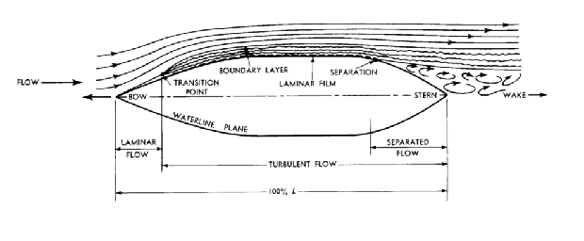
Coefficient of Viscous Resistance (C_{V})
Viscous Flow around a ship
Real ship : Turbulent flow exists near the bow.
Model ship : Studs or sand strips are attached at the bow
to create the turbulent flow.

Slide 27
Coefficient of Viscous Resistance (C_{V})
Coefficients of Viscous Resistance
- Non-dimensional quantity of viscous resistance
- It consists of tangential and normal components.
CF=tangential (skin friction) component of viscous resistance
KCF=normal (viscous pressure/form drag) component of viscous friction
normal
flow
tangential
bow
ship
stern
Tangential Component : C_{F}
- Tangential stress is parallel to ship’s hull and causes
a net force opposing the motion ; Skin Friction
- It is assumed can be obtained from the experimental
data of flat plate.

Slide 28
Coefficient of Viscous Resistance (C_{V})
Semi-empirical
equation

Slide 29
Boundary Layer Separation Resistance
Coefficient of Viscous Resistance (C_{V})
Bernoulli’s Equation:
p/ρ+V²/2+gz=constant
Viscous Pressure/Form Drag
Laminar Flow
Turbulent Flow
Boundary Layer
High Velocity/
Low Pressure
Low Velocity/
High Pressure
Low Velocity/
High Pressure
High Velocity/
Low Pressure
Boundary Layer Separation
Low Velocity/
High Pressure
Boundary Layer
Turbulent
Wake

Slide 30
Coefficient of Viscous Resistance (C_{V})
Tangential Component: C_{F}
- Relation between viscous flow and Reynolds number
· Laminar flow : In laminar flow, the fluid flows in layers
in an orderly fashion. The layers do not mix transversely
but slide over one another.
· Turbulent flow : In turbulent flow, the flow is chaotic and
mixed transversely.
Flow over
flat plate
Laminar Flow
Turbulent Flow

Slide 31
Coefficient of Viscous Resistance (C_{V})
Normal Component: KC_{F}
- Normal component causes a pressure distribution along the
underwater hull form of ship
- A high pressure is formed in the forward direction opposing
the motion and a lower pressure is formed aft.
- Normal component generates the eddy behind the hull.
- It is affected by hull shape.
Fuller shape ship has larger normal component than slender
ship.
large eddy
Full ship
Slender ship
small eddy

Slide 32
Coefficient of Viscous Resistance (C_{V})
Normal Component: KC_{F}
- It is calculated by the product of Skin Friction with Form Factor.

Slide 33
Coefficient of Viscous Resistance (C_{V})
K= Form Factor

Slide 34
Coefficient of Viscous Resistance (C_{V})
Reducing the Viscous Resistance Coeff.
Method :
Increase L while keeping the submerged volume constant
1) Form Factor K ↓ ⇒ Normal component KC_{F} ↓
∴ Slender hull is favorable. ( Slender hull form will create
a smaller pressure difference between bow and stern.)
2) Reynolds No. Rn ↑ ⇒ CF ↓ ⇒ KC_{F} ↓

Slide 35
Froude Number F_{n}
The Froude Number (inertia force/gravity force) is another dimensionless value
derived from model testing:
Fn = V
\/gL
Also used, but not dimensionless, is the Speed-to-Length Ratio:
Speed-to-Length Ratio = V
\/L
...Velocity is typically expressed in Knots (1 knot = 1.688ft/s)

Slide 36
Coefficient of Wave Resistance C_{W}
Typical Wave Patterns are made up of TRANSVERSE and DIVERGENT waves
Stern divergent wave
Bow divergent wave
Bow divergent wave
L
Transverse wave
Wave Length

Slide 37
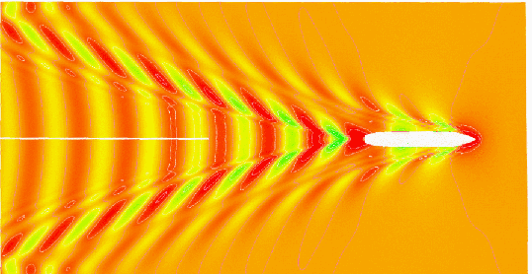
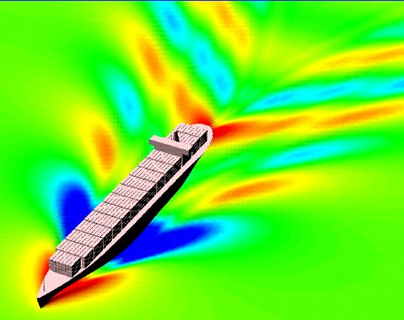
Coefficient of Wave Resistance C_{W}

Slide 38
Coefficient of Wave Resistance C_{W}
Transverse wave System
It travels at approximately the same speed as the ship.
At slow speed, several crests exist along the ship length
because the wave lengths are smaller than the ship length.
As the ship speeds up, the length of the transverse wave
increases.
When the transverse wave length approaches the ship length,
the wave making resistance increases very rapidly.
This is the main reason for the dramatic increase in
Total Resistance as speed increases.

Slide 39
Coefficient of Wave Resistance C_{W}
Transverse wave System
Vs < Hull Speed
Slow
Speed
Wave
Length
Vs ≈ Hull Speed
High
Speed
Wave Length
Hull Speed : speed at which the transverse wave length equals
the ship length.
(Wavemaking resistance drastically increases above hull speed)

Slide 40
Coefficient of Wave Resistance C_{W}
Divergent Wave System
It consists of Bow and Stern Waves.
Interaction of the bow and stern waves create the Hollow or
Hump on the resistance curve.
Hump : When the bow and stern waves are in phase,
the crests are added up so that larger divergent wave systems
are generated.
Hollow : When the bow and stern waves are out of phase,
the crests matches the trough so that smaller divergent wave
systems are generated.

Slide 41
Coefficient of Wave Resistance C_{W}
Air Resistance
Hollow
Hump
Wave-making
Resistance (lb)
Viscous
Speed (kts)
Low speed : Viscous R
Higher speed : Wave-making R
Hump (Hollow) : location is function of ship length and speed.

Slide 42
Coefficient of Wave Resistance C_{W}
Calculation of Wave-Making Resistance Coeff.
Wave-making resistance is affected by
- beam to length ratio
- displacement
- hull shape
- Froude number
The calculation of the coefficient is far difficult and inaccurate
from any theoretical or empirical equation.
(Because mathematical modeling of the flow around ship
is very complex since there exists fluid-air boundary,
wave-body interaction)
Therefore model test in the towing tank and Froude expansion
are needed to calculate the Cw of the real ship.

Slide 43
Coefficient of Wave Resistance C_{W}
It takes energy to produce waves, and as speed increases, the energy
required is a square function of velocity!
L_{wave} = 2πV²
g
The limiting speed, or hull speed, can be found as:
V = 1.34 \/L_{s}
Note: Remember at the hull speed, L_{wave} and L_{s} are approximately equal!

Slide 44
Coefficient of Wave Resistance C_{W}
Reducing Wave Making Resistance
1) Increasing ship length to reduce the transverse wave
- Hull speed will increase.
- Therefore increment of wave-making resistance of longer
ship will be small until the ship reaches to the hull speed.
- EX :
FFG7 : ship length 408 ft
hull speed 27 KTS
CVN65 : ship length 1040 ft
hull speed 43 KTS

Slide 45
Coefficient of Wave Resistance C_{W}
Reducing Wave Making Resistance
2) Attaching Bulbous Bow to reduce the bow divergent wave
- Bulbous bow generates the second bow waves .
- Then the waves interact with the bow wave resulting in
ideally no waves, practically smaller bow divergent waves.
- EX :
DDG 51 : 7 % reduction in fuel consumption at cruise speed
3% reduction at max speed.
design &retrofit cost : less than $30 million
life cycle fuel cost saving for all the ship : $250 mil.
Tankers & Containers : adopting the Bulbous bow

Slide 46
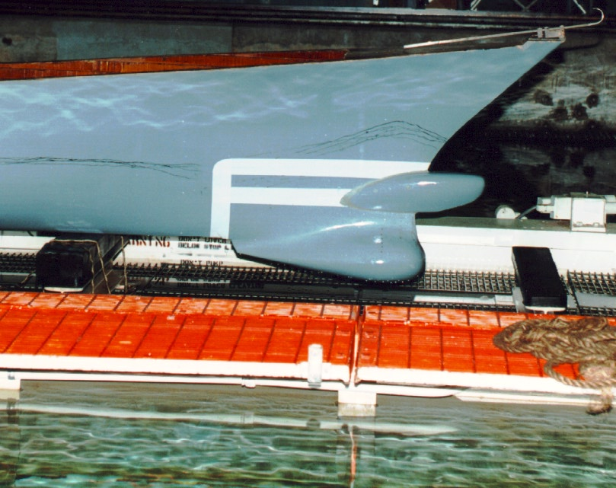
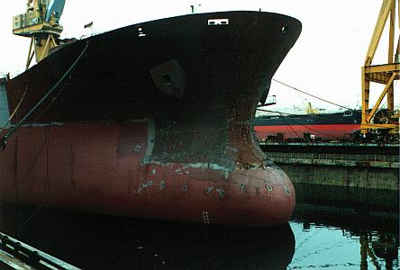
Coefficient of Wave Resistance C_{W}
Bulbous Bow

Slide 47
Coefficient of Total Resistance
Coefficient of total hull resistance
Correlation Allowance
It accounts for hull resistance due to surface roughness,
paint roughness, corrosion, and fouling of the hull surface.
It is only used when a full-scale ship prediction of EHP is made
from model test results.
For model,
For ship, empirical formulas can be used.

Slide 48
Other Type of Resistances
Appendage Resistance
- Frictional resistance caused by the underwater appendages
such as rudder, propeller shaft, bilge keels and struts
- 2∼24% of the total resistance in naval ship.
Steering Resistance
- Resistance caused by the rudder motion.
- Small in warships but troublesome in sail boats
Added Resistance
- Resistance due to sea waves which will cause the ship
motions (pitching, rolling, heaving, yawing).

Slide 49
Other Type of Resistances
Increased Resistance in Shallow Water
- Resistance caused by shallow water effect
- Flow velocities under the hull increases in shallow water.
Increase of frictional resistance due to the velocities
Pressure drop, suction, increase of wetted surface area
→ Increases frictional resistance
- The waves created in shallow water take more energy from
the ship than they do in deep water for the same speed.
→ Increases wave making resistance

Slide 50
Operating to Minimize Resistance
Keep the hull clean
Operate at a prudent speed
Keep speed below “hump speed” to optimize economy

Slide 51
7.7 Tow Tank Modeling
So far we’ve discussed what resistance is and how it can
quantified using:
- R_{T} by measuring the actual resistance force
- C_{T} dimensionless coefficients that can be used to compare
resistance between dissimilar hull shapes and sizes
We can now measure the resistance in a hull and use the data
to designing a ship’s power plant
- Using the resistance data, an effective power plant can be designed
- Taking into account the relationship between
- Effective Horsepower, EHP
- Shaft Horsepower, SHP

Slide 52
Tow Tank Modeling
Resistance and power are related!
R_{t} V_{s}
EHP
=
550 ft - lb
sec-HP
Resistance can be measured in two ways:
- Computer modeling
- Can be very difficult to mathematically model viscous flow in
3 dimensions
- Tow Tank testing
- Producing a geometrically and dynamically similar model to test
- Relate model performance to expected actual ship performance

Slide 53
Tow Tank Modeling
Tow Tank testing is the obvious way to go! But to do so, your
“model” ship must meet some criteria:
1. Geometric Similarity
- The dimensions of the model and ship must be scaled exactly
- The “Scale Factor” is called λ (lambda)
λ = L_{S} (ft)
L_{M} (ft)
λ² = S_{S} (ft²)
S_{M} (ft²)
λ³ = V_{S} (ft³)
V_{M} (ft³)
Length
Area
Volume
where: M = Model S = Ship
…Note that a “minor” error in any length measurement will be
cubed (n³)in volume scaling!

Slide 54
Tow Tank Modeling
2. Dynamic Similarity
- Motion of the vessel must also be scaled, including:
- Ship’s velocity
- Acceleration
- Viscosity of the water
- Dynamic similarity can only be approximated as water’s viscosity
and the forces of gravity can not be manipulated
C_{WM} = C_{WS}
C_{VM} = C_{VS}
- The trade-off is a “partial similarity”
- Froude’s Law of Comparison or “Law of Corresponding Speeds”

Slide 55
Tow Tank Modeling
The Law of Corresponding Speeds says:
V_{S} = V_{M}
L_{S} L_{M}

Slide 56
Tow Tank Modeling
We’ve already defined λ as:
λ = L_{S} (ft)
L_{M} (ft)
If we wanted to solve for the scale speed for the model,
V_{M} = V_{S} L_{M}
L_{S}
or V_{M} = V_{S} λ^{-1/2}
...NOTE! 1 kt is equal to 1.688 ft/sec! ALL velocities are done in feet/sec!

Slide 57
Example 1:
The USS Monitor was 197 ft long and 40 ft across the beam and was able to maintain a maximum speed of 6 kts. You would like to create a model for testing that is 5 ft long.
How wide should the model be? How fast should the model be towed to represent the actual ship’s max speed?
λ = L_{S}/L_{M}
λ = 197 ft /5 ft
λ = 39.4
Solving for the width,
λ = W_{S}/W_{M}
W_{M} = 40 ft/39.4
W_{M} = 1.015 ft

Slide 58
Solving for the maximum speed,
V_{S} = V_{M}
L_{S} L_{M}
V_{M} = V_{S} λ^{-1/2}
V_{M} = 6 kts (1.688 ft/sec-kts) x 39.4^{-1/2}
V_{M} = 10.128 ft/s x .1593
V_{M} = 1.6134 ft/s

Slide 59
Example 2:
The Yard Patrol (YP) is 110 ft long. It has a top speed of 13 kts on a good
day. It displaces 150 LT.
How long must a 1:25 scale model be? How fast must it be towed to
simulate the top speed?
λ = 25 (the scale is given!)
25 = L_{S}/L_{M}
L_{M}= 110ft/25
L_{M} = 4.4 ft (52.8 in)

Slide 60
Solving for the maximum speed,
V_{S} = V_{M}
L_{S} L_{M}
V_{M} = V_{S} λ^{-1/2}
V_{M} = 13 kts (1.688 ft/sec-kts) x 25^{-1/2}
V_{M} = 21.944 ft/s x .0.20
V_{M} = 4.39 ft/s

Slide 61
Example Problem
You are the chief Naval Architect assigned to design a new YP for the Naval Academy. You have already decided on a displacement, hull size and shape. You now need to use tow tank testing of a model to determine the engine size and fuel capacity required.
Ship Data:
Δ=300LT Length=100ft Beam=25ft Draft=6ft Wetted Surface Area=3225ft² Desired Max Speed=15kts

Slide 62
Example Problem
The maximum length of model which the tow tank can handle is 5ft. If the model is constructed of this length, to maintain geometric similarity, what would be its beam?
Maintaining geometric similarity, what is the wetted surface area of the model?
Maintaining geometric similarity, what is the displacement of the model in pounds? (Assume tow tank is seawater.)
Maintaining dynamic similarity, at what speed in ft/s do we need to tow the model?
At this speed, the model resistance is 6.58lb. Coefficient of Viscous Resistance (model)(C_{v})=0.0064 What is the wave making coefficient (C_{w})?
At 15kts, C_{v} for the ship is 0.0030. What is the resistance for the full size ship at this speed?
What is the EHP at this speed and, if we expect η_{p}=55%, how many SHP are required?

Slide 63
Example Answer
Scale Factor =λ=L_{s}/L_{m}=100ft/5ft=20; B_{m}=B_{s}/λ=25ft/20=1.25ft
A_{m}=A_{s}/λ²=3225ft²/20²=8.06ft²
Δ=F_{B}=ρgV Thus, it is proportional to submerged volume which is proportional to λ³; Δ_{m}=Δ_{s}/λ³=300LT×(2240lb/LT)/20³=84lbs
Law of Corresponding Speeds: v_{m}=v_{s}/λ^{½}=15kts×(1.688ft/s-kt)/20^{½}=5.7ft/s
C_{T}=R_{T}/(½ρSV²)=6.58lb/[½×1.99lb-s²/ft⁴×8.06ft²×(5.7ft/s)²]=0.0253; C_{w}=C_{T}-C_{v}=0.0253-0.0064=0.0189
C_{ws}=C_{wm}; C_{T}=C_{v}+C_{w}=0.0189+0.0030=0.0219
R_{T}=C_{T}×½ρSV²=0.0219×½×(1.99lb-s²/ft⁴)×3225ft²×(15kt×1.688ft/s-kt)²=45,100lb
EHP=R_{T}V/(550ft-lb/s-HP)=45,100lb×15kt×1.688ft/s-kt/(550ft-lb/s-HP)=2076HP; SHP=EHP/η_{p}=2076/0.55=3775HP

Slide 64
7.8 Screw Propellers
BLADE TIP
TIP CIRCLE
HUB
ROOT
SUCTION
BACK
PRESSURE
FACE
PROPELLER
DISC
ROTATION
TRAILING
EDGE
LEADING
EDGE

Slide 65
Screw Propellers
Definitions
Diameter(D) : distance from tip to tip
Hub : the connection between propeller and shaft
Blade Tip : the furthest point on the blade
Blade Root : the point where the blade meets the hub
Pitch(P) : Theoretical distance a propeller would move in
one revolution
Pitch Angle : Angle of the blade with respect to incoming flow.
It usually varies from root to tip.
Fixed Pitch :
- The pitch is constant all the way from the blade root to
the blade tip.
- Blade is fixed to the hub and cannot be altered.
Tip Circle : Circle described by the blade tip rotation
Propeller Disc : The area circumscribed by the propeller’s tip circle

Slide 66
Screw Propellers
Propeller Pitch
The distance that the blade travels in one revolution, P
- measured in feet
pitch
diameter
Hub

Slide 67
Screw Propellers
Propeller Pitch Angle
The pitch angle relates the pitch length to the circumference of the propeller blade:
tan φ = P
2πr
… Pitch angle φ is the angle that any part of the blade makes perpendicular with the water flow

Slide 68
Screw Propellers
Types of Propeller Pitch
1. Constant Pitch- The pitch angle does not change, it is the same at the root as at the tip of the blade, but the pitch will vary or the pitch does not change, but the pitch angle does change.
Variable Pitch- The pitch angle changes as the distance from the root changes (φ is defined at a blade radius of .7r)
Fixed Pitch- The blade is permanently attached to the hub and cannot
change.
Controllable Pitch- The position of the blade can be altered while the
blade rotates, thereby changing the pitch angle.

Slide 69
Screw Propellers
Definitions
Pressure face :
- High pressure side of blade. The astern side when going ahead
Suction Back : Low pressure side. Surface opposite the face
Leading edge : Forward edge of the blade, first to encounter the water stream
Trailing edge : Last part of the blade to encounter the water stream
Suction side
T.E.
L.E.
Pressure side

Slide 70
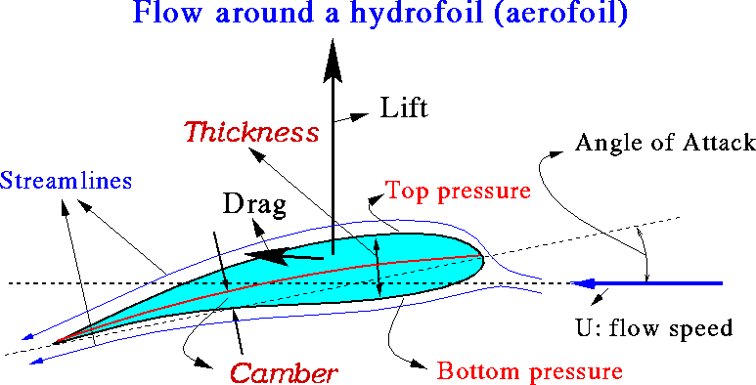
Screw Propellers

Slide 71
Propeller Action
Screw Propellers
Forward
Resistance to
Propeller Rotation
Propeller Thrust
Reaction Force
on Propeller
Propeller Rotation
Relative Motion of Water Flow
Suction Back
Pitch
Angle
High Pressure Face

Slide 72
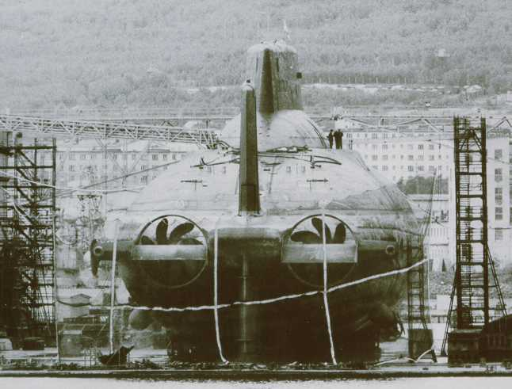
Screw Propellers
Propeller Rotation
Left hand screw
- Rotates Counter Clock-wise when viewed from astern
- Single screw ships use this type
Right hand screw
- Rotates Clock-wise when viewed from astern
Naval Ship
Counter Rotating Propellers
- Have both a right and left hand screw
- Eliminates torque created by the rotation
- Torque will cause the stern to make a turn in the direction of rotation
Submarines & torpedoes

Slide 73
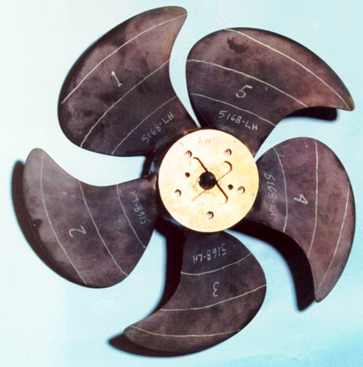
Screw Propellers
The Skewed Propeller
Highly Skewed Propeller for a DDG 51
Advantages:
Reduced interaction between propeller and rudder wake
- Reduced vibration and noise
Disadvantages:
Expensive
Less efficient operating in reverse

Slide 74
Screw Propellers
Propeller Theory
Speed of Advance
P
Wake Region
Q
The ship drags the surrounding water . This wake follows the
ship with a wake speed (Vw).
The flow speed at the propeller is,
Speed of Advance

Slide 75
Screw Propellers
Propeller Theory
Propeller Efficiency
(~70 % for well-designed PP.)
Maximum
- For a given T (Thrust),
Ao
(i.e., Diameter ) ; CT ; Prop Eff.
The larger the diameter of propeller, the better the propeller efficiency

Slide 76
Screw Propellers
Propellers generate thrust as soon as they
rotate, even before the ship starts moving
K_{T}=T/(ρn²D⁴)
K_{T}=thrust coefficent
ρ=water density
n=shaft RPM
D=propeller diameter

Slide 77
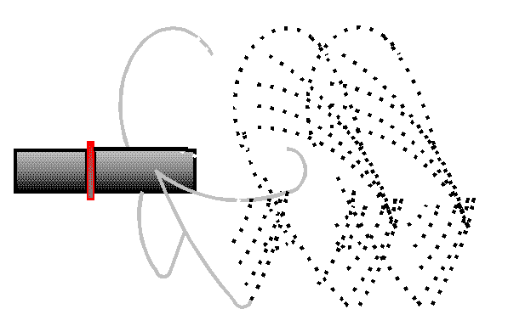
Screw Propellers
Propeller Cavitation
The formation and collapse of vapor bubbles on propeller blades where the pressure has fallen below the vapor pressure of water
Cavitation occurs on propellers that are heavily loaded, or are experiencing a high thrust loading coefficient

Slide 78
Screw Propellers
Cavitation Process
Pressure
(atm)
Vaporization Line
LIQUID
1.0
A
B
(‘A’ to ‘B’ – boiling water)
Pv
VAPOR
C
(‘A’ to ‘C’ – cavitation)
20
100
Temperature (°C)
Vapor pressure
15°C 0.25 psi
100°C 14.7psi=1atm
=101 kPa

Slide 79
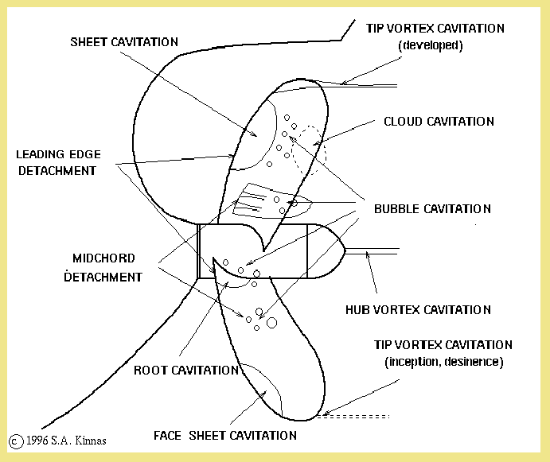
Screw Propellers

Slide 80
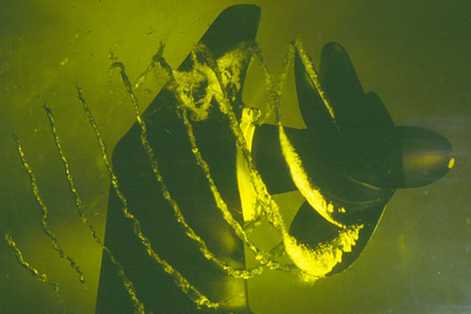
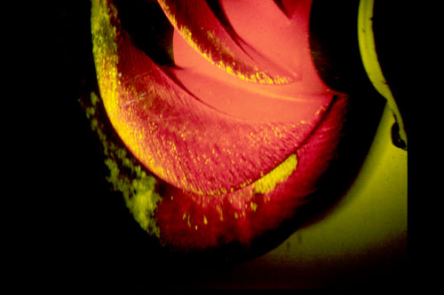
Screw Propellers
Blade Tip Cavitation
Navy Model Propeller 5236
Flow velocities at the tip are fastest so that pressure drop occurs at the tip first.
Sheet Cavitation
Large and stable region of
cavitation covering the suction
face of propeller.

Slide 81
Screw Propellers
Consequences of Cavitation
1) Low propeller efficiency (Thrust reduction)
2) Propeller erosion (Mechanical erosion)
(Severe damage to propeller : up to 180 ton/in²)
3) Vibration due to uneven loading
4) Cavitation noise due to impulsion by the bubble collapse

Slide 82
Screw Propellers
Preventing Cavitation
Remove fouling, nicks and scratch.
Increase or decrease the engine RPM smoothly to avoid
an abrupt change in thrust.
rapid change of rpm ⇒ high propeller thrust but small
change in VA ⇒ larger CT ⇒ cavitation &
low propeller efficiency
Keep appropriate pitch setting for controllable pitch propeller
For submarines, diving to deeper depths will delay or prevent
cavitation as hydrostatic pressure increases.

Slide 83
Screw Propellers
Ventilation
If a propeller operates too close to the water surface, surface
air or exhaust gases are drawn into the propeller blade due to
the localized low pressure around propeller.
The load on the propeller is reduced by the mixing of air or
exhaust gases into the water causing effects similar to those
for cavitation.
Ventilation often occurs in ships in a very light condition(small
draft) and in rough seas.

Slide 84
Example Problem: Name the parts of a propellers:
__________________
___
_________
__________
__________
______________
____________
_____________
_____________
____________
R
Direction
of Rotation
Forward

Slide 85
Example Answer: Name the parts of a propellers:
Propeller Radius (R)
Hub
Blade Tip
Blade Root
Tip Circle
Propeller Disc
Leading Edge
Trailing Edge
Pressure Face
Suction Back
R
Direction
of Rotation
Forward

